Slide 1
Computer Graphics (L12)
EG678EX
Visible Surface Detection
Prepared By: Dipesh Gautam

Slide 2
Visible Surface Detection
Two approaches
  Depends upon object definition or projected image
    Object-space
      Compares objects and parts of objects to each other within the scene
    Image-space
      Visibility is decided point by point at each pixel position on projected plane
Prepared By: Dipesh Gautam

Slide 3
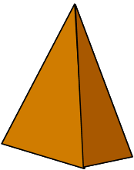
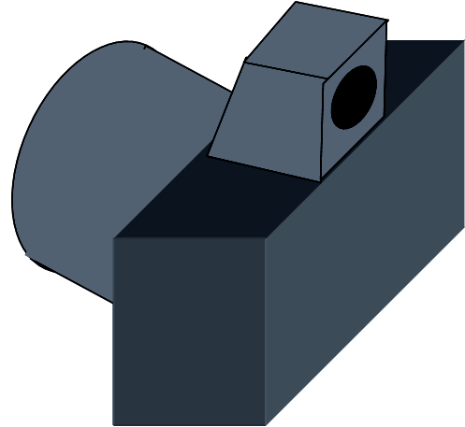
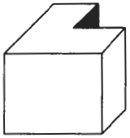
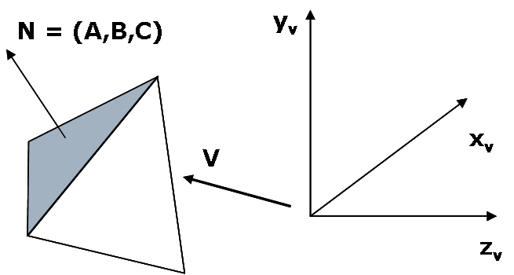
Back Face Detection Method
N
V
Fast and simple object-space method
Based on “inside” or “outside” test
Test whether view point is inside or outside the polygon surface
  Tested by the inequality: Ax + By + Cz + D = 0
    If view point is outside the surface → visible
    If inside → back face
  The test could be simplified by considering normal vector N = (A,B,C) to polygon surface and Vector V in viewing direction as:
    the polygon is back face if: V.N>0
If object description is converted to viewing co-ordinates then, V is along z_{v} axis i.e V = (0,0,V_{z}), then:
    V.N = V_{z}C
    i.e V.N > 0 → V_{z}C
So we need to consider only sign of C
For right handed viewing system with viewing direction along negative z_{v} axis, c<0 → back face
Convex polyhedron?→ no problem because either completely visible or completely hidden
Concave polyhedron?→ some problem; needs additional faces
More than one objects? in scene → problem
Eliminates about half of the polygon surface in a scene from further visibility tests
      What if C = 0 ??
      Grazing Viewing i.e viewing direction is perpendicular to surface normal→ also back face
      So, back face if C≤0
Prepared By: Dipesh Gautam

Slide 4
Depth Buffer (z-Buffer) method
Image-space method
Surface depth is compared at each pixel position on the projection plane
Usually applied to scene containing only polygon surfaces; but possible to apply for non-planar surfaces
For each pixel position (x,y) on projection plane, object depths can be compared by comparing z-values as each (x,y,z) position on a polygon surface corresponds to the orthographic projection point (x,y) on projection plane
Two buffers required
  Depth buffer: to store depth value for each position
  Refresh buffer: to store intensity values of each position
Drawback: Deals only with opaque surface but not with transparent surface
Prepared By: Dipesh Gautam

Slide 5
Depth Buffer (contd…)
Initialize the depth buffer and refresh buffer so that for all buffer positions (x,y),
  depth(x,y) = 0, refresh(x,y) = Ibackgrnd
For each position on each polygon surface, compare depth values to previously stored values in the depth buffer to determine visibility
    Calculate the depth z for each (x,y) position on the polygon
    If z>depth(x,y), then set
      depth(x,y)=z, refresh(x,y)=Isurf(x,y)
s₃
s₂
s₁
y_{v}
(x,y)
x_{v}
      I_{backgrnd} = background intensity
      I_{surf}(x,y) = projected intensity value for the surface at pixel position (x,y)
z_{v}
Prepared By: Dipesh Gautam

Slide 6
Area Subdivison
It is based on a divide & conquer method. It uses fundamental of area coherence. It is used to resolve the visibility of algorithms. It classifies polygons in two cases i.e. trivial and non-trivial.
Trivial cases are easily handled. Non trivial cases are divided into four equal subwindows. The windows are again further subdivided using recursion until all polygons classified trivial and non trivial.
Prepared By: Dipesh Gautam

Slide 7
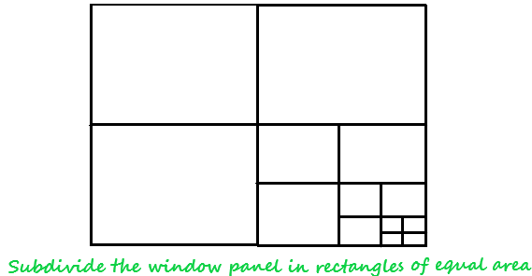
Subdivision
Prepared By: Dipesh Gautam

Slide 8
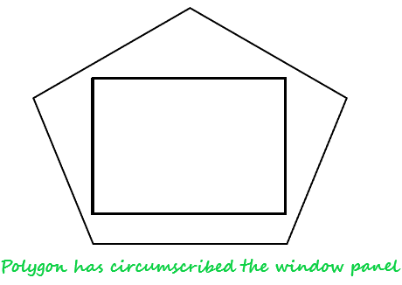
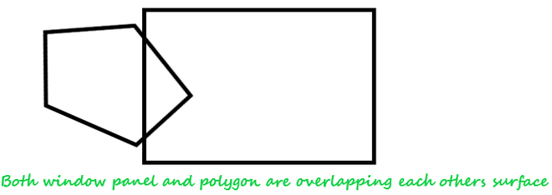
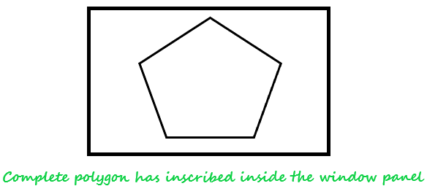
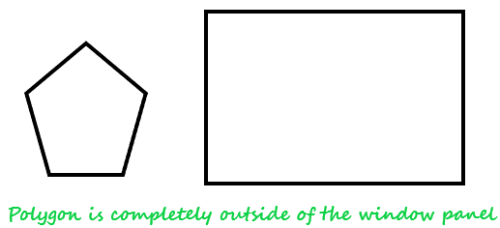
Prepared By: Dipesh Gautam

Slide 9
Classification of Scheme
It divides or classifies polygons in four categories:
Inside surface
Outside surface
Overlapping surface
Surrounding surface
Prepared By: Dipesh Gautam

Slide 10
Prepared By: Dipesh Gautam

Slide 11
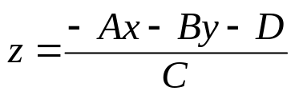


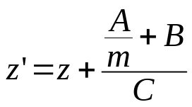
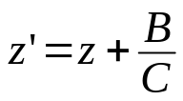
Depth Buffer (depth calculation)
From plane equation, depth is
For the next adjacent pixel in a scan line, depth is
Determine minimum and maximum y-coordinates for each polygon
Start from top scan line to bottom scan line
Starting from top vertex, calculate x position down the left edge of the polygon recursively as
x’ = x – 1/m
Thus depth value for the next pixel in left edge is obtained as
For vertical edge m = infinity, so:
y
y-1
or
x
x+1
top scan line’
y scan line
left edge intersection
m(x’-x)=y’-y=-1
bottom scan line
put x’ = x-1/m and y’ = y-1
y scan line’
y-1 scan line’
x
X’
Prepared By: Dipesh Gautam

Slide 12
A-Buffer Method
background
opaque
surface
foreground
transparent
surface
Extension of depth buffer method
Antialiased, area-average, accumulation-buffer
The depth buffer is expanded so that each position in the buffer can reference a linked list of surfaces thus enabling more than one surface intensity consideration
The object boundary could be antialiased
Each pixel position in the A-Buffer has two fields
  Depth Field → stores a positive or negative real number
    Positive→ single surface contributes to pixel intensity
    Negative → multiple surfaces contribute to pixel intensity
  Intensity Field → stores surface-intensity information or a pointer value
    Surface intensity if single surface → stores the RGB components of the surface color at that point and percent of pixel coverage
    Pointer value if multiple surfaces
  in case of surface linked list, the data for each surface in the linked list includes
    RGB intensity
    Opacity parameter
    Depth
    Percent of area coverage
    Surface identifier
    Other surface-rendering parameters
    Pointer to next surface
  Scanlines are processed to determine surface overlaps of pixels across the individual scanlines.
  Surfaces are subdivided into a polygon mesh and clipped against the pixel boundaries
  The opacity factors and percent of surface overlaps are used to determine the pixel intensity as an average of the contribution from the overlapping surfaces
d>0
I
depth
field
intensity
field
d<0
Surf1
Surf2
depth
field
intensity
field
Prepared By: Dipesh Gautam

Slide 13
Scan-Line Method
Extension of scanline algorithm for filling polygon interiors
Instead of filling just one surface, we deal with multiple surfaces
Construct edge tables and polygon tables
  Edge table contains → endpoints of each edge in the scene, inverse slope of each line and pointers to the polygon table to identify its corresponding surface
  Polygon table contains → plane equation coefficients, surface intensity, pointers to the edge table (optional)
Setup an active list (why active ??) of edges for those edges which cross the current scan line
  The edges are sorted in order of increasing x
Define flags for each surface to indicate whether a position is inside or outside the surface
  At leftmost boundary of surface flag == on and at rightmost boundary flag == off
Prepared By: Dipesh Gautam

Slide 14
Scan-Line Method (contd…)
B
E
For scan line 1
  The active edge list contains edges AB,BC,EH, FG
  Between edges AB and BC, only flags for s1 == on and between edges EH and FG, only flags for s2==on
    no depth calculation needed and corresponding surface intensities are entered in refresh buffer
For scan line 2
  The active edge list contains edges AD,EH,BC and FG
  Between edges AD and EH, only the flag for surface s1 == on
  Between edges EH and BC flags for both surfaces == on
    Depth calculation (using plane coefficients) is needed.
    In this example depth for s1 is less than for s2, so intensities for surface s1 are loaded into the refresh buffer until boundary BC is encountered
  Between edges BC and FG flag for s1 == off and flag for s2 == on
    Intensities for s2 are loaded on refresh buffer
For scan line 3
  Same coherent property as scan line 2 as noticed from active list, so no depth calculation needed between edges BC and EH
y_{v}
F
A
Scan Line 1
S1
S2
Scan Line 2
Scan Line 3
H
C
D
G
x_{v}
Prepared By: Dipesh Gautam

Slide 15
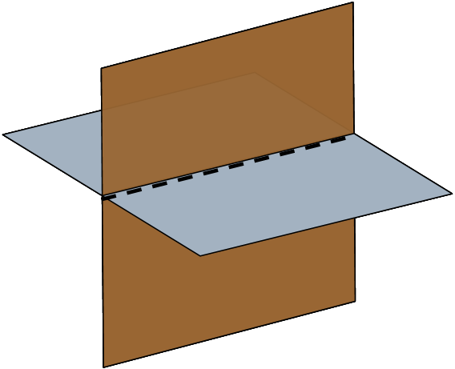
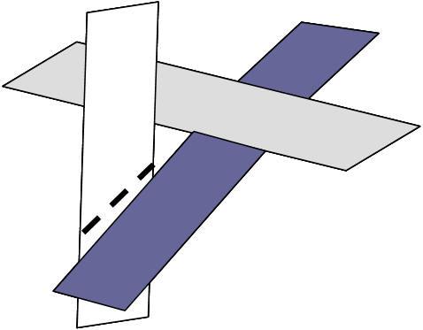
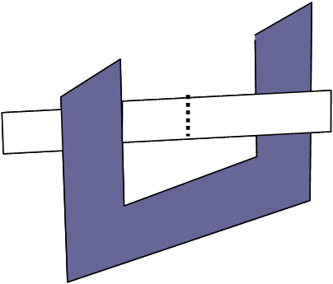
Scan-Line Method (contd…)
Problem: Dealing with cut through surfaces and cyclic overlap is problematic when used coherent properties
  Solution: Divide the surface to eliminate the overlap or cut through
Subdividing line
Subdividing line
y_{v}
E
B
F
Scan Line 1
A
Scan Line 2
Subdividing line
S1
S2
Scan Line 3
Scan Line 4
H
C
D
G
x_{v}
Prepared By: Dipesh Gautam

